Slide 1




PROJECT REPORT
The Spectral Soil Modeler
An Automated Machine Learning Workflow for Soil Spectroscopy
Akshat Kotadia
Jewel Joseph
Gaurav Patel
Parv Shah
Eshwar Pingili
Course: Software Systems Development | Instructor: Abhishek Singh | Team 01

Slide 2


The Bottleneck in Soil Research
The Problem
Developing predictive models for soil properties (like Clay, Sand, or Organic Carbon) is currently a manual, labor-intensive process.
•
Researchers must manually test every combination of preprocessing techniques and algorithms.
•
Human error susceptibility increases with repetitive tasks.
•
Significant time lost on routine configuration rather than analysis.
Problem Statement

Slide 3
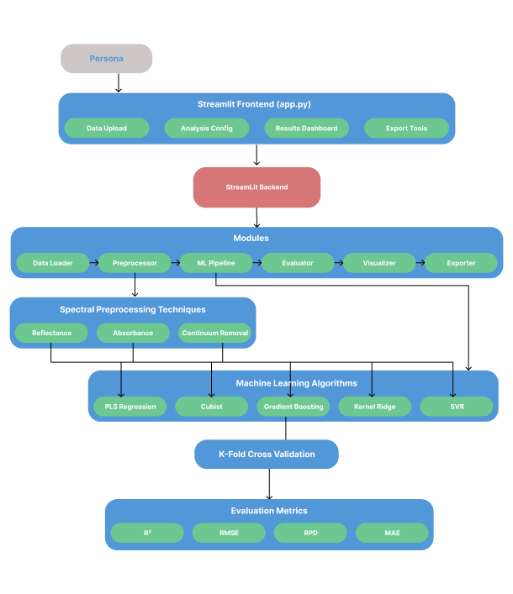
The Solution
One-Click Automation
We built a robust web application that automates the entire lifecycle of model creation.
Key Capabilities:
•
Automated Data Ingestion & Preprocessing
•
Hyperparameter Tuning (GridSearchCV)
•
Interactive Visualization Dashboard

Slide 4







System Architecture
A specialized monolithic architecture designed for research stability and speed.
Monolithic Streamlit
MongoDB Atlas
ML Engine
Shifted from FastAPI/Microservices to a unified Streamlit application. This simplifies state management for long-running ML tasks and reduces overhead.
Secure, cloud-based storage for user authentication (bcrypt hashing) and potential future session metadata storage.
Powered by Scikit-learn and Cubist. Handles complex pipelines including PLSR, GBRT, KRR, and SVR with nested cross-validation.
Architecture Details

Slide 5




The Automated Pipeline
1. Ingestion
2. Preprocessing
3. Modeling
4. Tuning
Upload CSV/XLS. Auto-detection of features and target variables.
Applies strategies: Reflectance, Absorbance, Continuum Removal.
Trains 5 models: PLSR, Cubist, GBRT, KRR, SVR.
5-Fold Cross-Validation with nested GridSearchCV.
Methodology

Slide 6




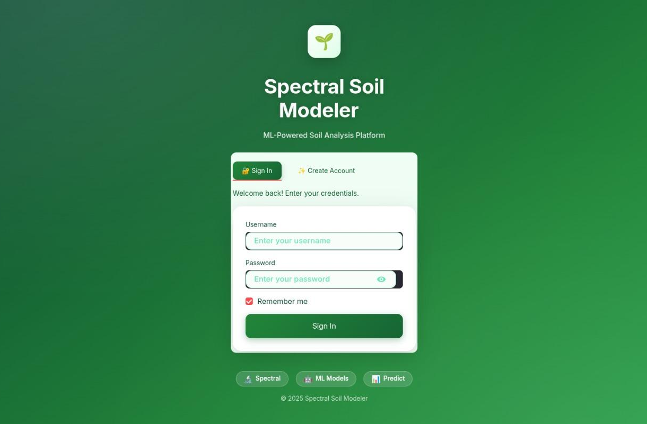

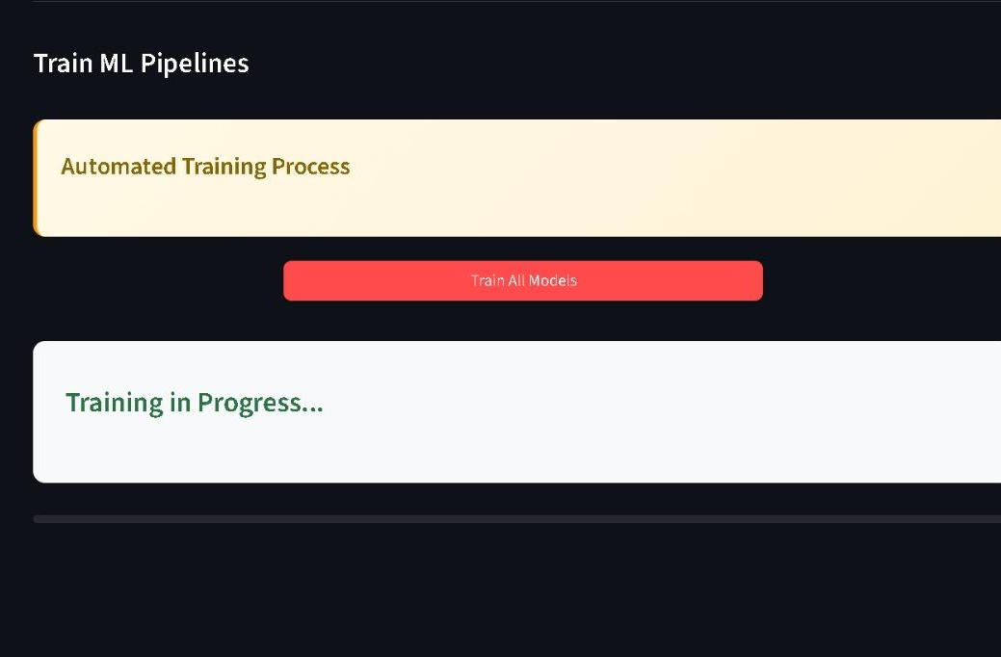

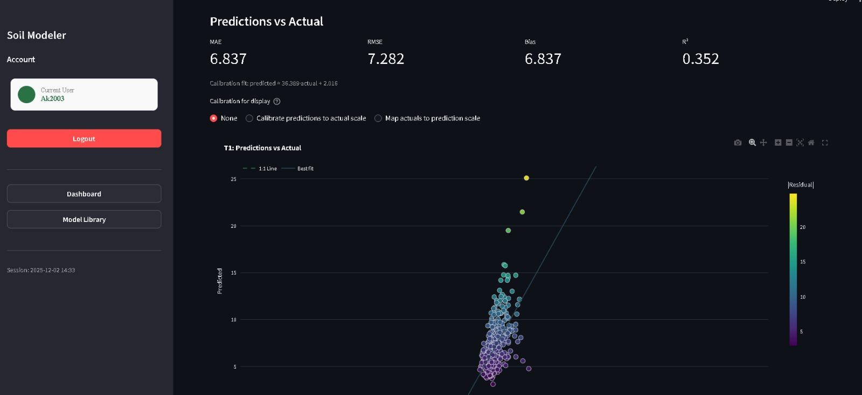
User Interface Walkthrough
Secure Login
Training Hub
Results Dashboard
MongoDB-backed authentication ensures user data security and session persistence.
Intuitive sidebar for uploading data, selecting targets, and monitoring training progress.
Leaderboards, download options for model artifacts, and detailed diagnostic plots.
UI Features

Slide 7

Technical Deep Dive
The Cubist Challenge
Hyperparameter Tuning Strategy
The third-party Cubist library was incompatible with Scikit-learn's parallel processing (n_jobs=-1), causing crashes.
We integrated GridSearchCV inside the cross-validation loop. This ensures tuning happens only on the training set of each fold.
The Fix:
Prevents data leakage.
Implemented a dedicated sequential grid search block strictly for Cubist models within the orchestration layer, maintaining system stability without sacrificing model performance.
Provides realistic performance estimates.
Implementation Details

Slide 8
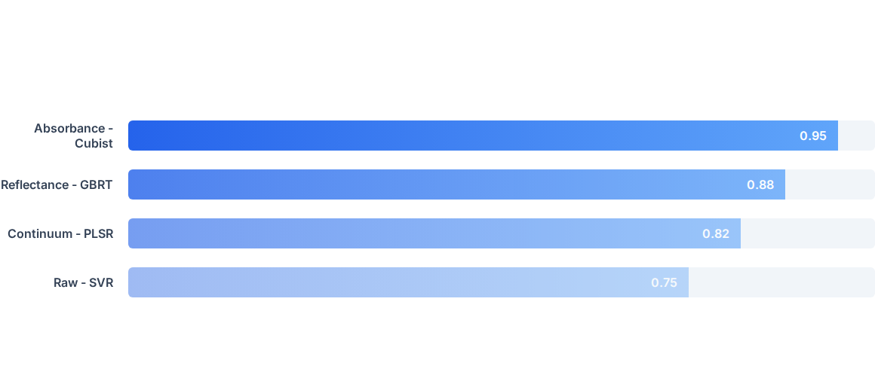
Model Performance Leaderboard
Comparison of top performing pipeline combinations based on R-Squared ( R 2 ) metric.
* Note: Values represent optimal test cases. Cubist models typically outperform PLSR in non-linear soil property prediction.
Results Analysis

Slide 9

Interactive Diagnostics
Visualizing Model Trust
The dashboard provides granular insight into model behavior:
•
Predicted vs. Actual: Scatter plots aggregating all 5 CV folds to visualize accuracy against the 1:1 line.
•
Feature Importance: Permutation importance charts highlight which spectral bands drive the model's decisions.
•
Downloadable Artifacts: Users can export plots, model objects (.pkl), and logs.
Visualization

Slide 10

Conclusion & Future Work
Summary
The Spectral Soil Modeler successfully transforms a multi-day manual research task into a streamlined, automated workflow, enabling reproducible science.
Roadmap
Job Queue: Implement Celery + Redis for robust concurrency.
API Layer: FastAPI endpoints for programmatic access.
Cloud Registry: S3 integration for long-term model versioning.
Roadmap

Slide 11

Q&A
Thank you for your attention.
The Spectral Soil Modeler
Team 01
github.com/parv-the-coder/SSD-Soil_Modeler

